Slide 1

North Western University, Khulna
Title: Introduction to Computer Network Using NS2 Based on the Domain as www.github.com
Course Code: CSE-3304
Course Title: Computer Networks Sessional
December 24,2022

Slide 2




Details Of Team Members
Name: Nayan Sarkar
ID: 20201126010
Department Of CSE
North Western University
Khulna, Bangladesh
Moupia Mazumder Mou
ID: 20201146010
Department Of CSE
North Western University
Khulna, Bangladesh
Name: Asmaul Husna Mony
ID: 20201157010
Department Of CSE
North Western University Khulna, Bangladesh

Slide 3
Overview
1. Bird’s eye view of the project.
2.Introduction to Zen Map
3.Different host to domain
4.Design network topology
5.Prepare excel sheet for network diagram
6.Introduction to NS2
7.Source code of NS2
8.Output topology of NS2
9.Summarization of the designed network
10.Conclusion
11.Reference
December 24,2022

Slide 4
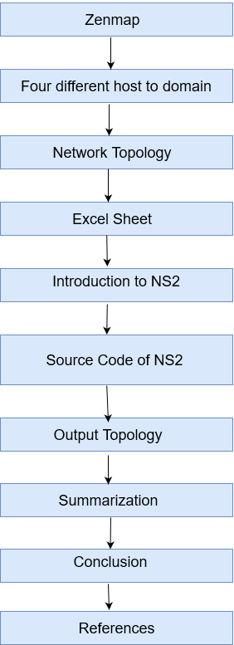
Bird’s eye view of the project.
Fig 1: Bird’s eye view of the project.
December 24,2022

Slide 5
Introduction to Zen Map
Zenmap is the official graphical user interface (GUI) for the Nmap Security Scanner.
Features of ‘Zenmap’
Zenmap keeps track of scans until deleted
Zenmap command profiles make it easy to run same scan more than once
No need for a shell script to do common scan
Zenmap analyses and displays the complete details related to hosts such as OS version, installed services, services status and uptime etc.
December 24,2022

Slide 6
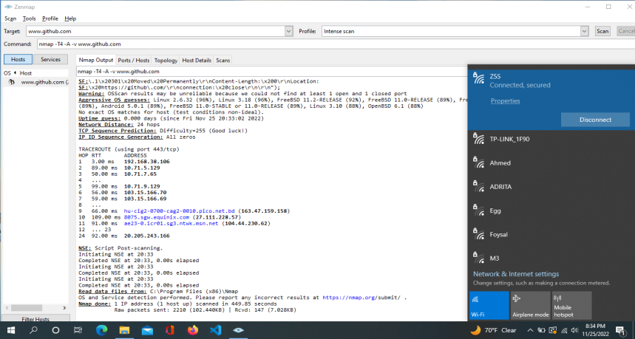
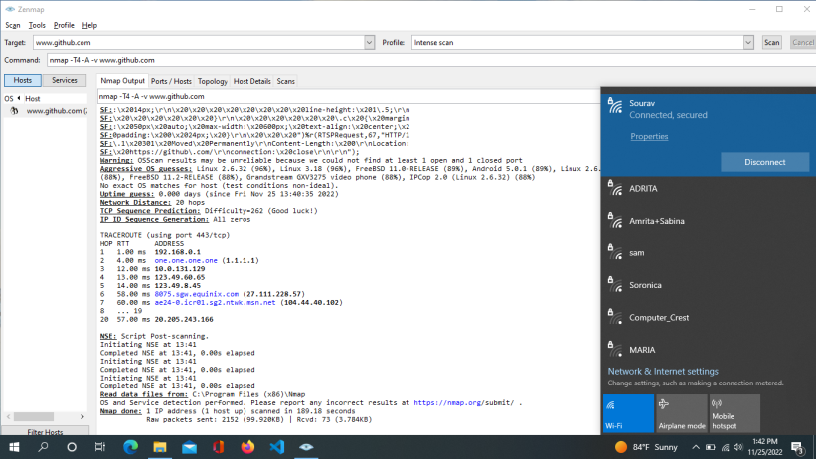
Four different host to domain
Domain name: www.github.com
A domain name is a unique, easy-to-remember address used to access websites, such as 'google.com', and 'github.com'. Users can connect to websites using domain names thanks to the DNS system. Domain Registration.
Fig 2: Banglalink network Zen map scan output.
Fig 3: Radiant Network ISP Zen map scan output.
December 24,2022

Slide 7


Fig 4: Red Network ISP Zen map scan output.
Fig 5: Robi network Zen map scan output.
December 24,2022

Slide 8
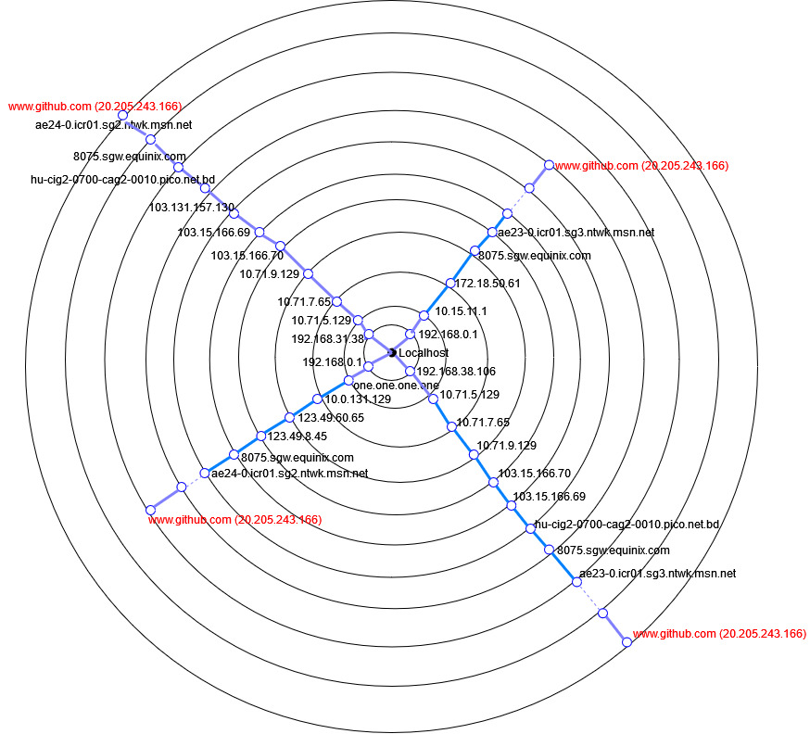
4. Design Network Topology
December 24,2022
Fig : Network topology of Github

Slide 9
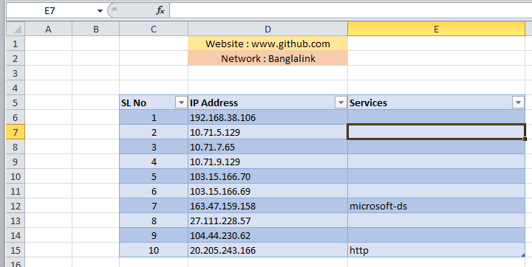
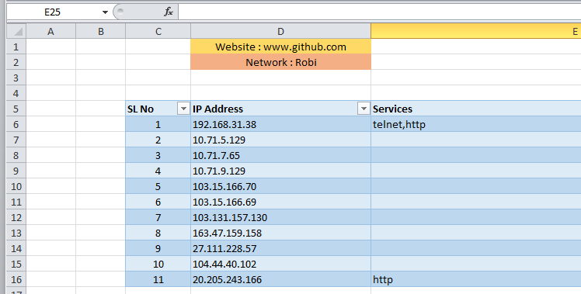
5. Excel sheet for Network Diagram:
Fig : Service table of Banglalink.
Fig : Service table of Robi.
December 24,2022

Slide 10
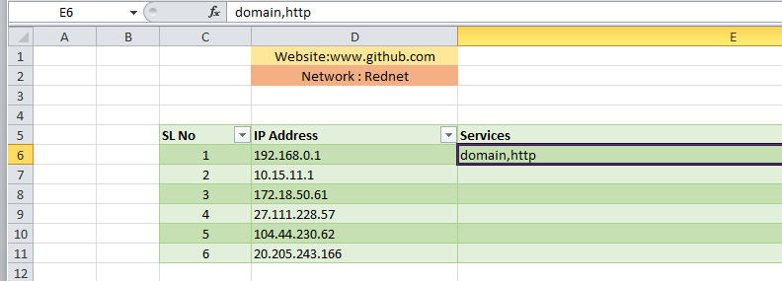
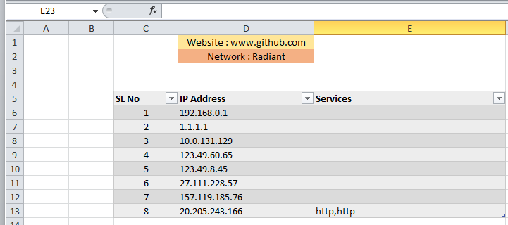
Fig : Service table of Rednet.
December 24,2022
Fig : Service table of Radiant.

Slide 11
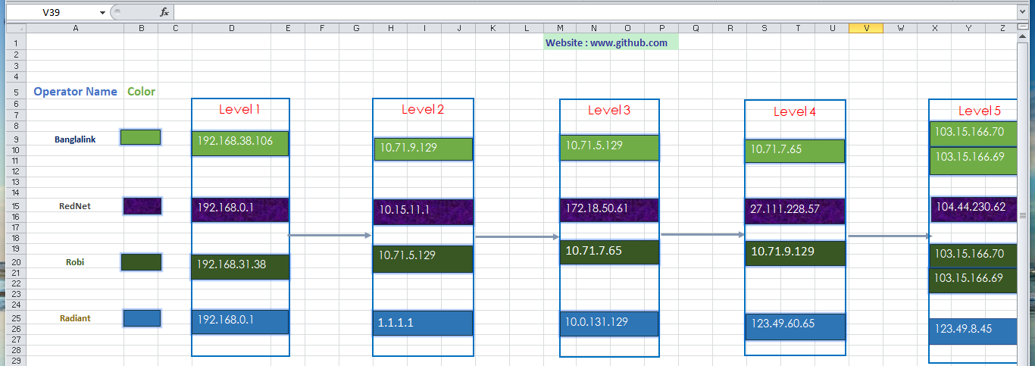
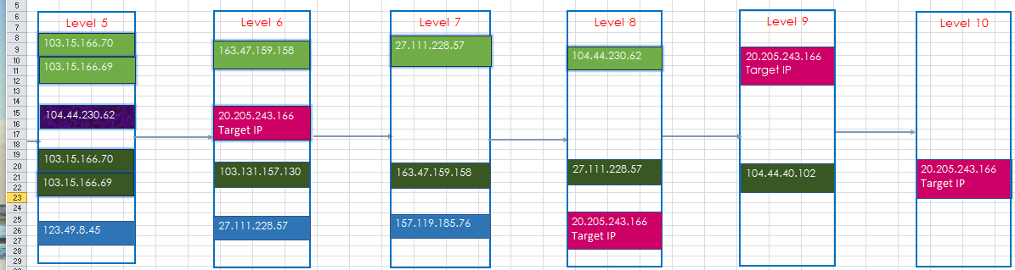
Fig : First-half excel sheet tracert.
December 24,2022
Fig : Last-half excel sheet tracert.

Slide 12
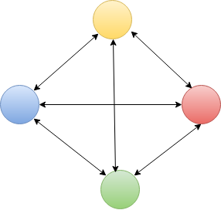
6. Introduction to NS2:
Network Simulator (Version 2)
discrete event simulator for networking research
Works at packet level
Event drive simulation tool
Wired/wireless network ,protocols (routing algorithms, TCP, UDP)
Standard experiment environment in research community
December 24,2022

Slide 13
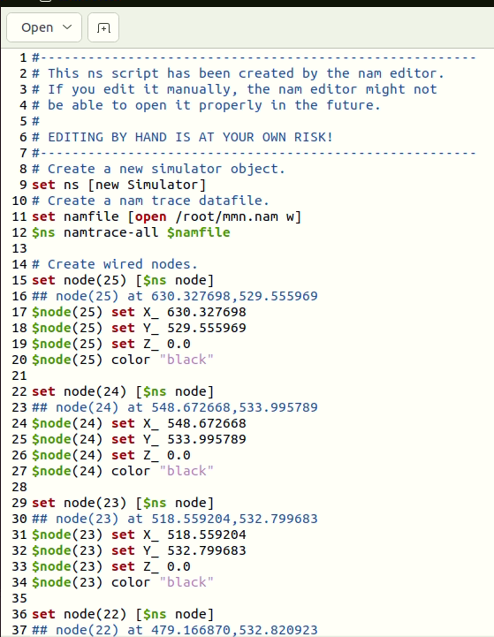
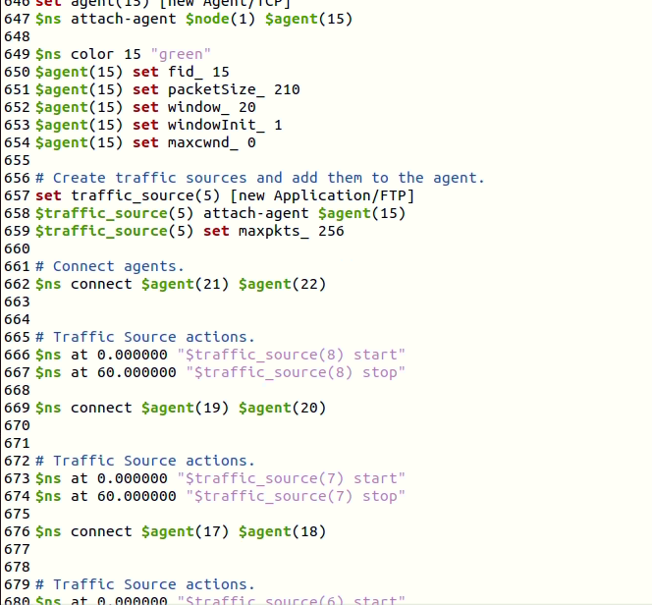
7. Source Code of NS2:
December 24,2022
Fig : Source code of NS2.

Slide 14
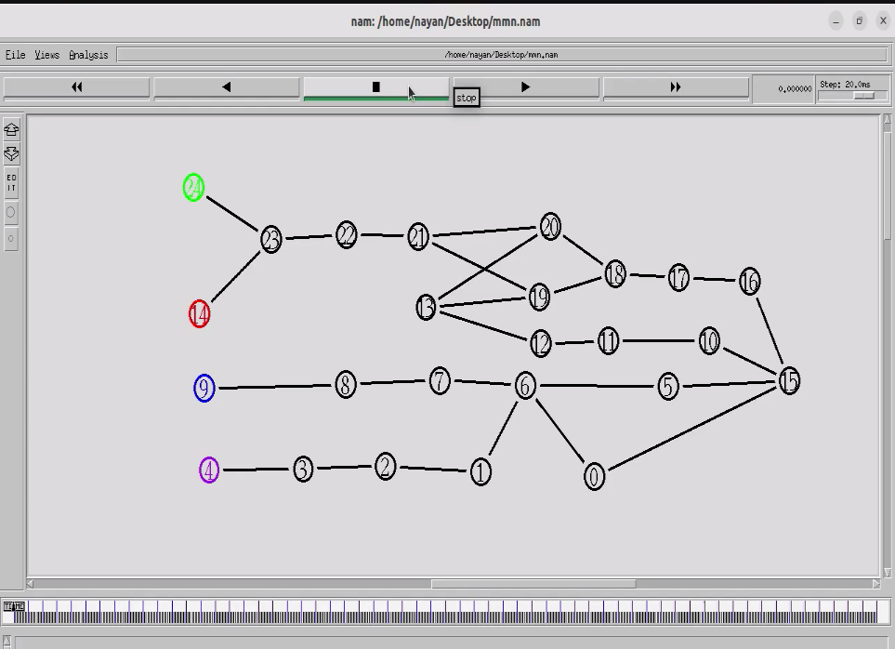
8. Output topology of NS2:
There are three figures in this output topology of NS2. The first output of NS2 is:
Figure: Network topology for simulation (Before Run).
December 24,2022

Slide 15
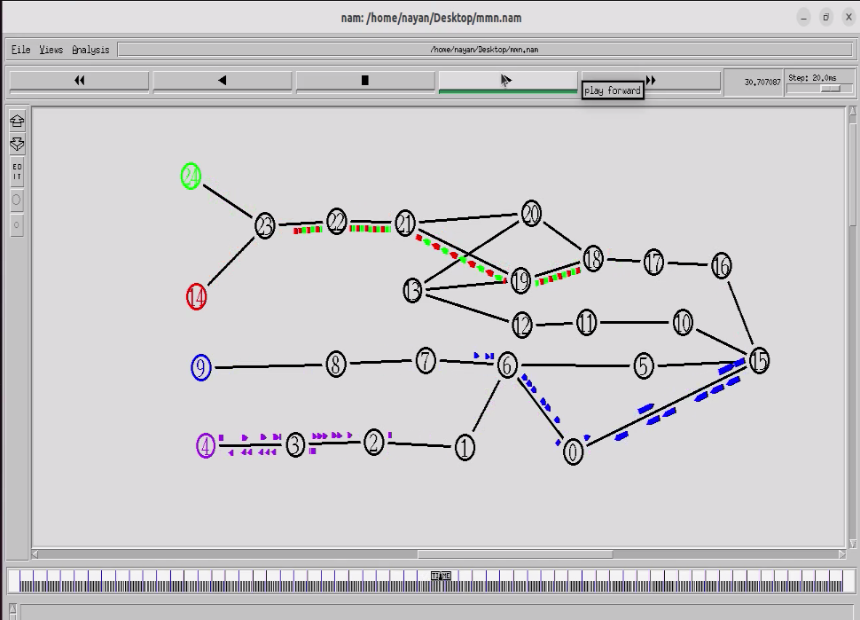
The second output of NS2 is:
Figure: Network topology for simulation (Running).
December 24,2022

Slide 16
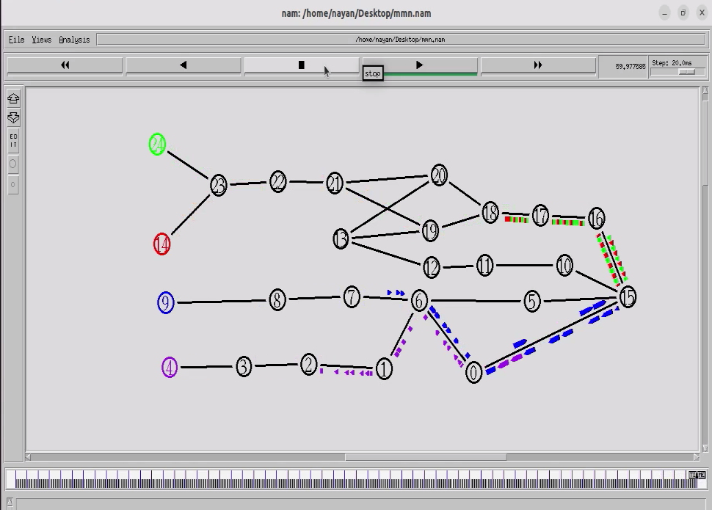
The third output of NS2 is:
Figure: Network topology for simulation (After Run).
December 24,2022

Slide 17
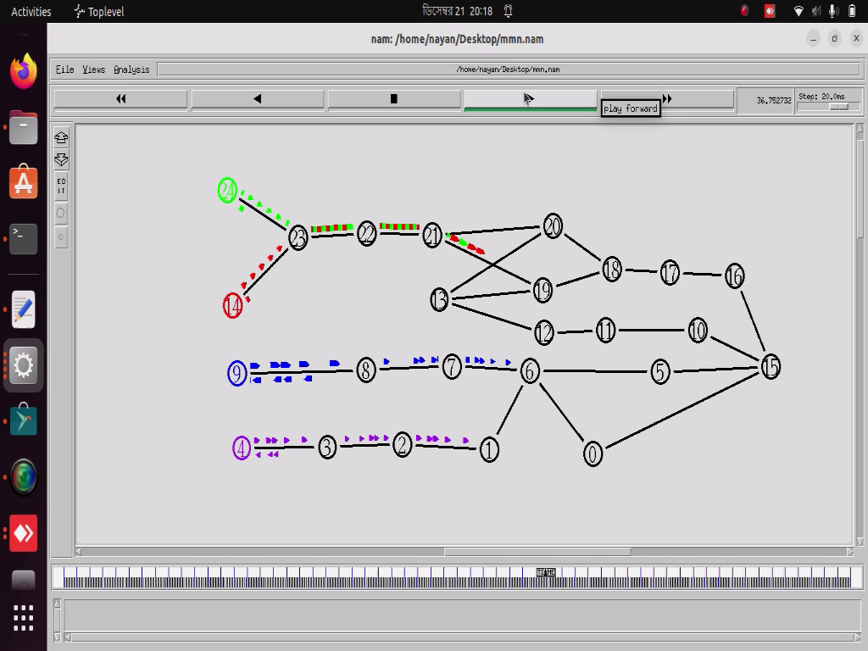
9. Summarization of the Designed Network:
Traffic flow, packet flow or network flow is a sequence of packets from a source computer to a destination, which may be another host.
Figure: Traffic flow for packet from source to receiver
December 24,2022

Slide 18
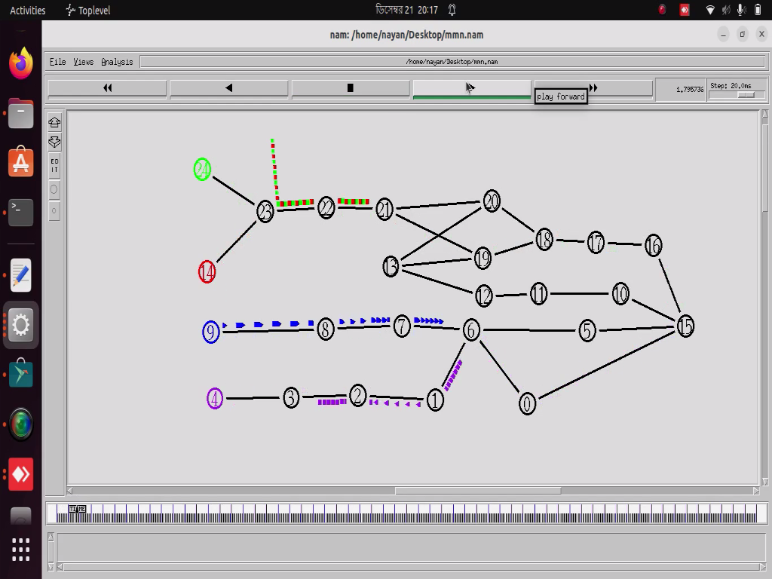
There can be various reasons for packet loss:
Network transport is unreliable
The network link could be congested.
Applications cannot handle the
offered load.
The packet loss is occur when several
server applications are running and
also for incoming traffic.
18
18
Figure: Packet drop at gateway when buffer is full.
December 24,2022

Slide 19
10. Conclusion:
The aim and objectives of the project has been achieved through learning the basic on how to use Zen map, NS2 software and Ubuntu operating system.
Zen map provides a graphical user interface for network scanning.
The codes have been compiled and run based on the network simulation software of NS2.
Ubuntu is a open-source Linux-based operating system you can use on a computer or virtual private server.
December 24,2022

Slide 20
11. References:
1. https://ipwithease.com/introduction-to-zenmap-nmap-network-mapper/?fbclid=IwAR3oWRPd6svfLvL9pfiadHZbVsQP7BttySOiCja0fWb8SVd_yxgv70rDC6U
2. https://www.google.com/search?q=domain%20name%20describe&fbclid=IwAR3EicWLDwP4Qnaw-EDfklq1XRJNnXRoskQzNQO5DGm_QIsWvRw0khFAqEo
3.https://www.researchgate.net/publication/264158147_Communication_and_Computer_Networks_Simulator_NS2/link/57acb7ff08ae0932c974ac3f/download
December 24,2022

Slide 21

December 24,2022

